Slide 1
Windows IoT Core
Presenter Name
Title
Contact Info

Slide 2
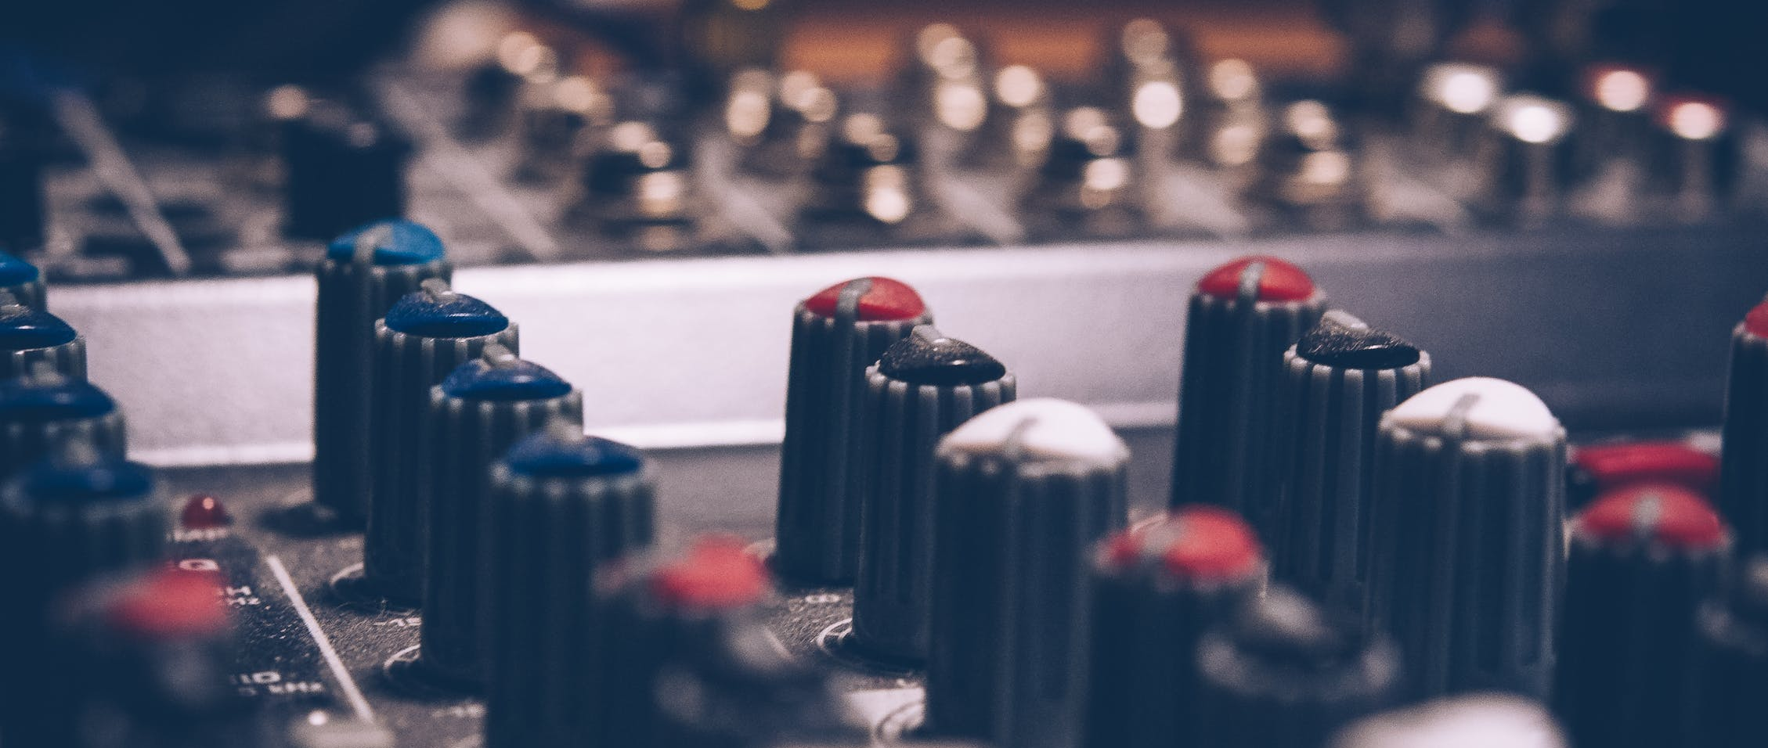
Windows IoT Core
Hands on Lab
 Event Code MSFTEVENT XXXXX  WiFi MSFT GUEST
Notes:
Hi, I’m ___, and I’m excited to discuss Windows IoT Core, and the value it can deliver to your organization.
Pick one of these 2 slides

Slide 3
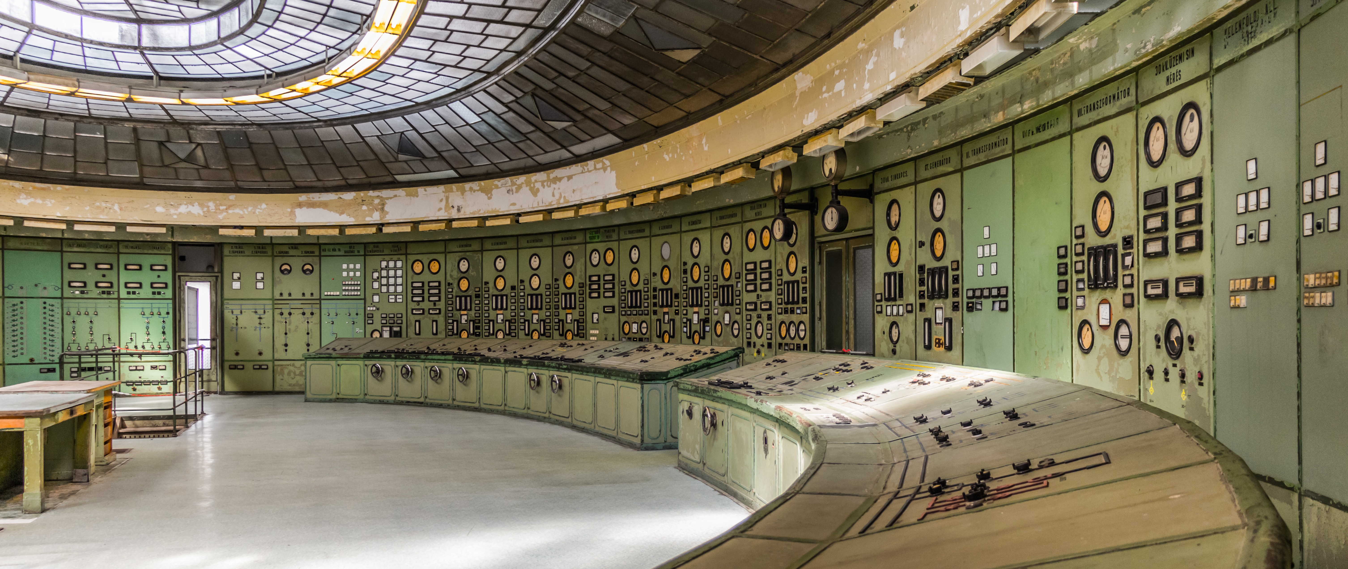
Windows IoT Core
Hands on Lab
 Event Code MSFTEVENT XXXXX  WiFi MSFT GUEST
Notes:
Hi, I’m ___, and I’m excited to discuss Windows IoT Core, and the value it can deliver to your organization.
Pick one of these 2 slides

Slide 4
Logistics
 Month 00, 20xx
X day(s) event
 8:00AM – 5:00PM
🍔 12:00PM – 1:00PM
Lunch Room Around the Corner
🚻 On the left down the hallway
 Event Code MSFTEVENT XXXXX  WiFi MSFT GUEST

Slide 5
Topics Covered
IoT Core Introduction
Tools Needed (Quick Start)
App Development / Driver Development
Commercialization
Building Test Images
Building Custom Retail Images
Securing Devices
IoT Core Services
Azure Integration
Manufacturing Flow
Debugging

Slide 6

Windows IoT Core.
Small footprint, smart edge devices
Notes:
Now we’re going to learn how Windows 10 IoT provides value at every step along the journey of creating and running an IoT solution

Slide 7
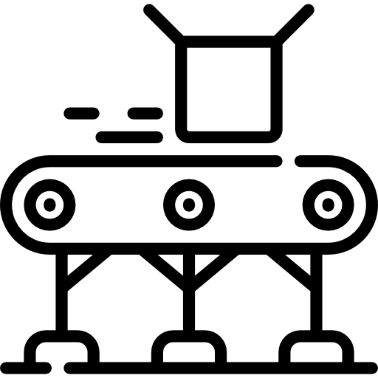







The Internet of Things cuts across industries
Manufacturing
Smart cities
Transportation
Retail
Healthcare
Energy
Public Safety
Agriculture
Notes:
Examples of IoT scenarios, use as much or as little as appropriate.
Implement smart manufacturing with Microsoft IoT solutions
Monitor manufacturing equipment
Improve your processes using industrial IoT. Use sensors and advanced analytics to predict parts need maintenance, reducing unplanned downtime that cuts into production time.
Monitor customer equipment
Create new business models that offer predictive maintenance and performance monitoring for the equipment you produce, delivering a richer customer experience.
Improve field service
Access sensor data to improve field service scheduling, ensuring the right technicians and tools are dispatched before potential issues become a major problem.
Transform cities with Microsoft IoT solutions
Optimize energy use
Apply usage tracking and smart grids to deliver a reliable, efficient, and greener energy transmission while lowering rates for customers.
Create safer cities
Connect infrastructures to better regulate traffic, make emergency systems more efficient, and reduce police and EMT response times.
Create smart buildings
Connect building devices and systems to bring more efficient operation and control to building owners, operators, and occupants.
Improve field service
Improve public service efficiency, from repairing broken street lamps to maintaining traffic lights to optimizing garbage truck routes.
IoT for water
Monitor the quality and environmental conditions of water utilities for cleaner drinking water, while tracking water consumption to save money and reduce usage.
Improve transportation and logistics with Microsoft IoT
Maintain vehicle performance
Keep vehicles on the road by predicting and monitoring maintenance needs—fixing potential issues during downtime to keep your business moving.
Enable IoT in cars and vehicles
Create innovative IoT-enabled vehicle capabilities and solutions that transform the customer driving experience while bringing valuable insights to your business.
Optimize fleet operations
Streamline logistics using real-time data and alerts to optimize delivery routes, monitor performance, and quickly respond to delays or issues as they happen.
Engage customers with Microsoft IoT retail solutions
IoT for food service
Increase efficiencies to reduce your operating costs. Monitor quality and safety, improve equipment maintenance, and track supplies.
IoT for vending machines
Streamline your operations. Track inventory and supply usage, and better predict machine maintenance needs.
IoT for supermarkets and retail stores
Increase business growth and brand loyalty. Monitor inventory, track consumer behavior, and recommend products.
IoT for hospitality
Optimize operations and increase revenues. Track room usage, tailor to guest preferences, and know before supplies run low.
IoT for stadiums
Improve the spectator experience by connecting them with their favorite sporting events through real-time statistics and tracking.
Improve processes and patient care with Microsoft IoT solutions
Monitor patient care
Allow patients to receive care at home where they're most comfortable. With wearable sensors, doctors can remotely track and respond to a patients’ health status in real time.
Monitor medical assets
Help your staff spend less time searching and more time with patients by better tracking and managing supplies and medicine—all on a cloud platform that's HIPAA compliant.
Maintain vital equipment
Ensure critical medical devices are ready to use when your patients need them most by fixing problems before they occur with predictive maintenance.
Track equipment usage
Enhance the overall well-being of patients by tracking how equipment is used, from employing hospital bed sensors to monitoring room temperature and hand washing stations.
Understand energy usage to be more cost efficient
IoT for energy consumption
Understanding energy usage patterns and use machine learning to reduce costs.
IoT for energy production
Better align energy production with demand, create smart grids, and optimize solar panel performance using remote monitoring and predictive maintenance.
IoT for Oil & Gas
Drive performance and efficiency by tracking oil and gas usage and disposal, monitoring equipment, and predicting problems before they happen.
IoT for agriculture and aquaculture
Connect every step of production—from environmental conditions to equipment to goods produced—to more efficiently produce a greater yield.

Slide 8
The Internet of Things opportunity
21 Billion Connected “things” by 2020
— Gartner
80 Billion Connected “things” by 2025
— IDC
180 Zettabytes digital data
— IDC
$457 Billion Global IoT Market by 2020
—Gartner
70%
of value enabled by IoT will come from B2B scenarios
McKinsey & Company
Notes:
Talking Points:
You’ve probably have heard a lot about IoT.
There’s a lot of noise out there and there are number of companies talking about IoT.
There are big numbers being thrown around.
According to latest IDC’s report, the IoT market is expected to be $1.7 trillion by 2020
Gartner predicts that there will be over $25 Billion connected “things” by 2020..
There is so much hype around IoT that IoT is beginning to sound like - If it’s a dumb thing, let’s just put a chip on it and voila you have smart thing..
Transition:
Once you get past all the confusion and noise and realize just how simple and powerful IoT can be, the next question becomes: “What can it do for my business?”

Slide 9
Modern business imperatives
Reduce costs and inefficiencies
Increase
revenue
Reduce costs and inefficiencies
Notes:
Talking Points:
You’ve probably have heard a lot about IoT.
There’s a lot of noise out there and there are number of companies talking about IoT.
There are big numbers being thrown around.
According to latest IDC’s report, the IoT market is expected to be $1.7 trillion by 2020
Gartner predicts that there will be over $25 Billion connected “things” by 2020..
There is so much hype around IoT that IoT is beginning to sound like - If it’s a dumb thing, let’s just put a chip on it and voila you have smart thing..
Transition:
Once you get past all the confusion and noise and realize just how simple and powerful IoT can be, the next question becomes: “What can it do for my business?”

Slide 10
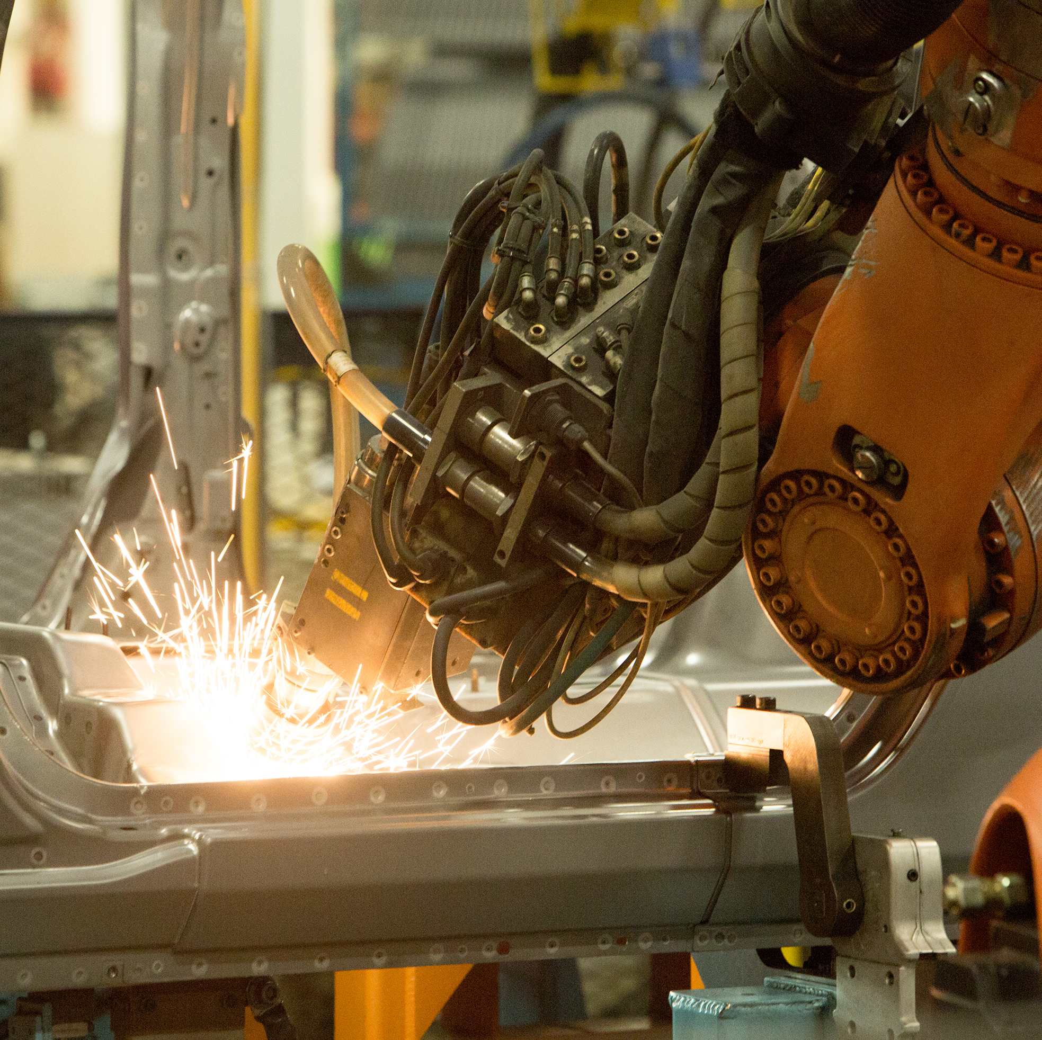
Digital Transformation
Notes:
From: https://enterprise.microsoft.com/en-us/digital-transformation/
Become a Digital Business
“Every company is a software company. You have to start thinking and operating like a digital company. It’s no longer just about procuring one solution and deploying one. It’s not about one simple software solution. It’s really you yourself thinking of your own future as a digital company.”
– Satya Nadella CEO, Microsoft
What is digital transformation?
Digital transformation is about reimagining how you bring together people, data, and processes to create value for your customers and maintain a competitive advantage in a digital-first world.

Slide 11
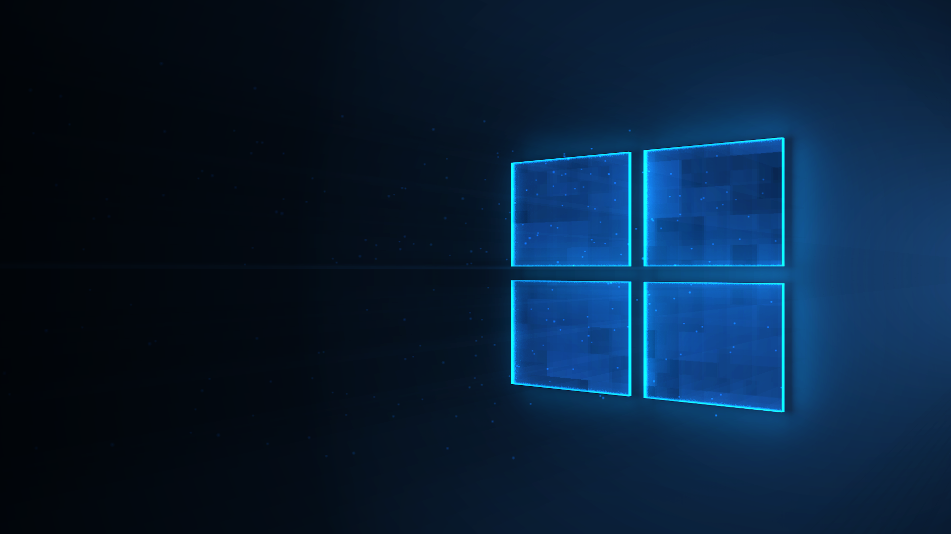
Digital Transformation
Notes:
From: https://enterprise.microsoft.com/en-us/digital-transformation/
Become a Digital Business
“Every company is a software company. You have to start thinking and operating like a digital company. It’s no longer just about procuring one solution and deploying one. It’s not about one simple software solution. It’s really you yourself thinking of your own future as a digital company.”
– Satya Nadella CEO, Microsoft
What is digital transformation?
Digital transformation is about reimagining how you bring together people, data, and processes to create value for your customers and maintain a competitive advantage in a digital-first world.

Slide 12
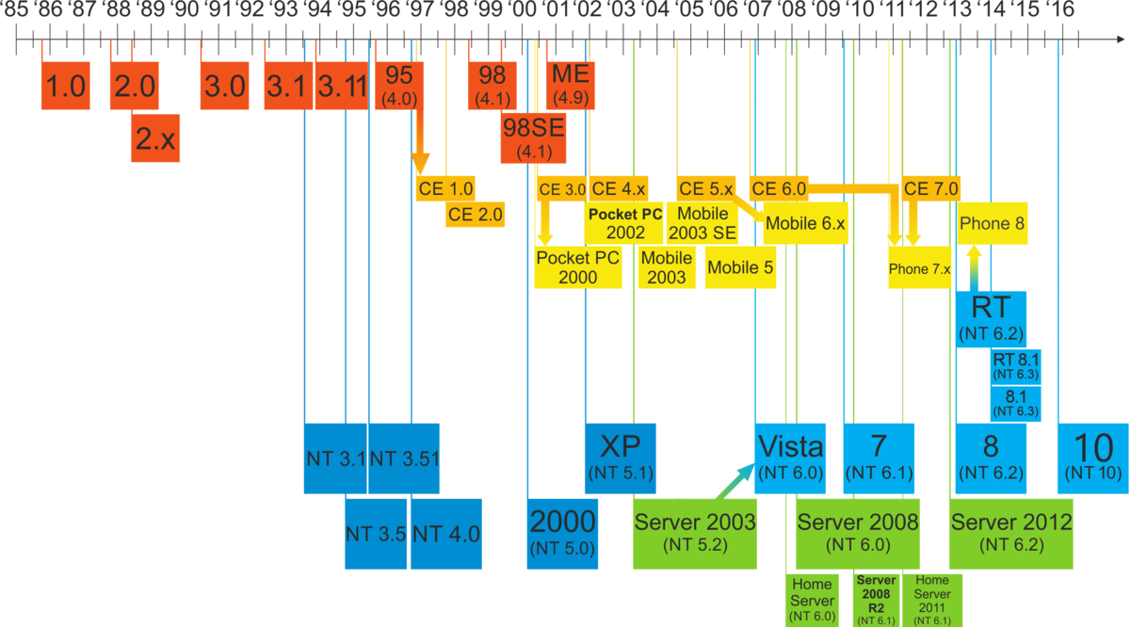
Windows and Versions

Slide 13
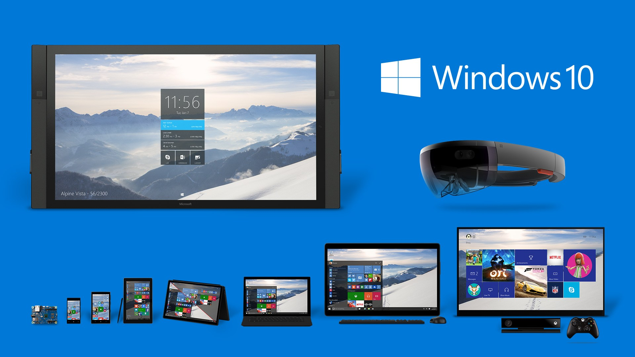

Slide 14
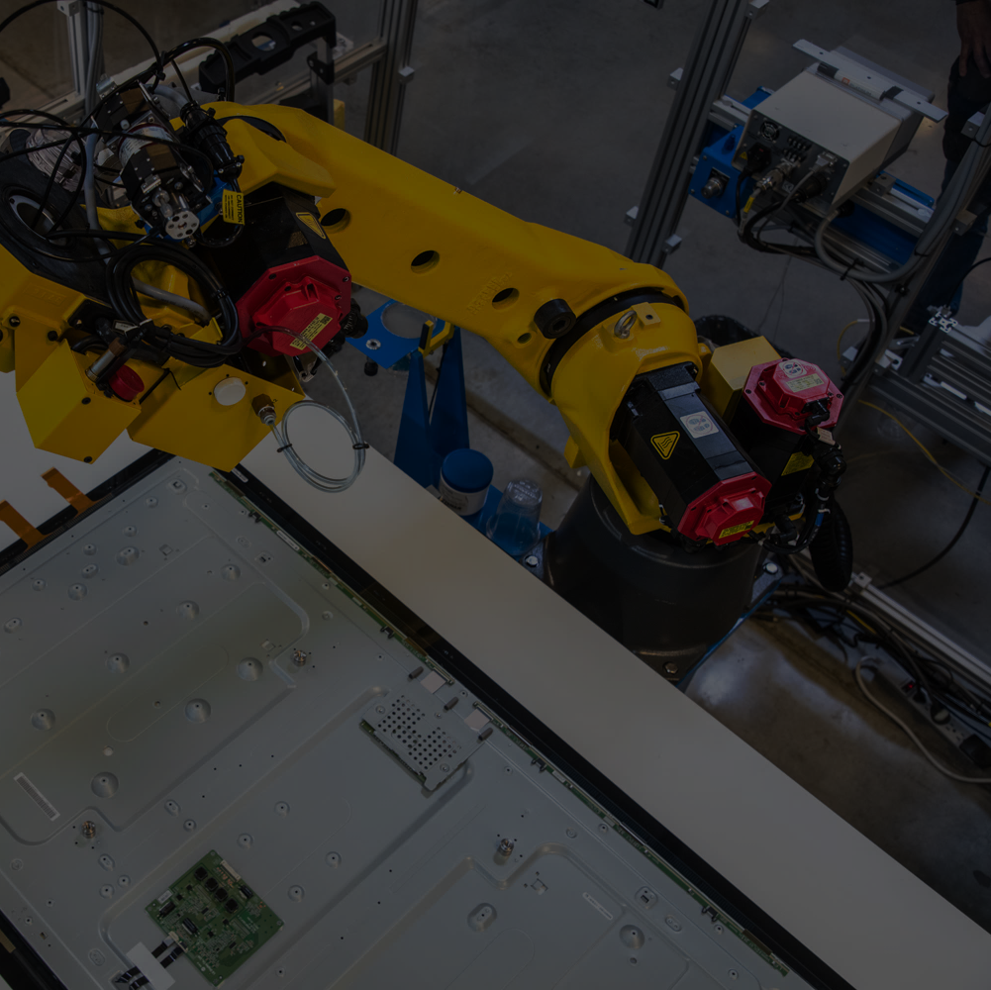
Open platform that seamlessly connects things, endpoints, and the cloud
Commercial OS for IoT devices and a modern user experience
Supports the languages and frameworks you already know
Windows 10 IoT
Trusted platform for security and servicing of for cloud-connected devices
Bring power and capability to the edge
Enable a more nature user interface
Notes:
Azure Time Series Insights is a fully managed analytics, storage, and visualization service that makes it incredibly simple to explore and analyze billions of events simultaneously.
Time series data represents how an asset or process changes over time
Time series data has a timestamp and time most meaningful as an axis
Storing, indexing, querying, analyzing, and visualizing is challenging
IIoT exponentially generating more time series data

Slide 15
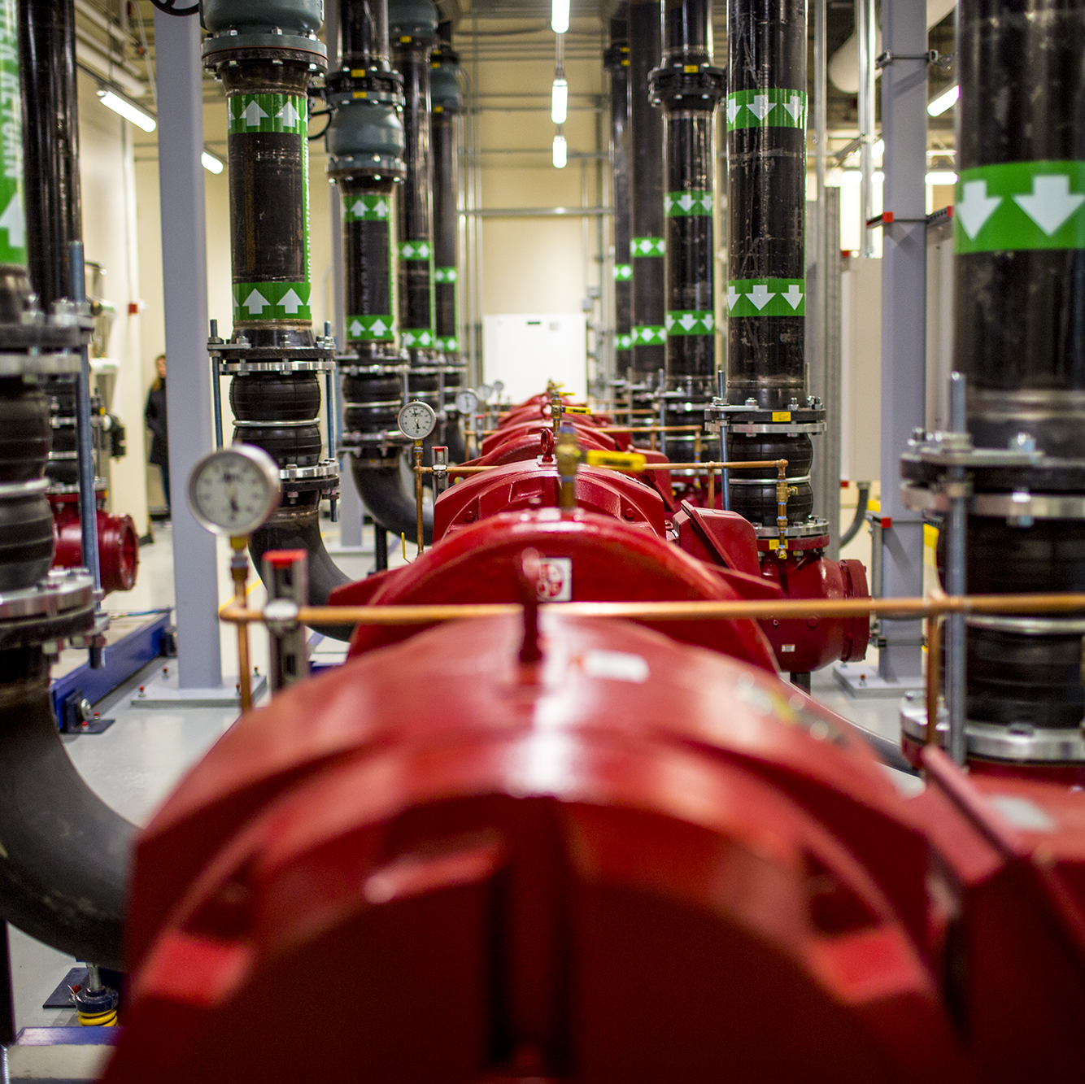
Windows 10 for your Internet of Things
“As an operating system, Windows 10 is much more mature than its competitors. If you’re dependent on how you can innovate at the device level, then you’re better off picking a more intelligent platform, and that’s where Windows helps us out.”
— Chad Brown, XOGO CEO
Notes:
Now we’re going to focus on how Windows 10 IoT can help your business

Slide 16

Windows 10 IoT Benefits
Faster time- to-market
Intelligent security
Intelligent edge
Integrated with cloud offering
Notes:
Create and deploy your solutions faster
Secure your solution from the device to the cloud
Put real smarts in your edge devices
Windows IoT & Azure IoT – Better Together
Microsoft IoT combines Windows IoT and Azure IoT for complete edge to cloud solutions
You don’t have to find, integrate and secure components from multiple vendors which increases support complexity.
Microsoft is a single point of support

Slide 17

Security is our #1 focus
Microsoft is leading IoT Security
Secure lifecycle management of IoT Devices using Device Provisioning Service, Device Management and a host of security features
Cutting edge of device identity and attestation with DICE, available today through our silicon partners
Empowering you to design, deploy and operate secure IoT through best practices, Security Program
Leading in standards and regulations

Slide 18








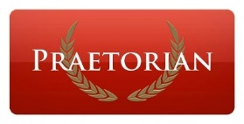



Partnering for the best IoT security
Microsoft’s Security Program for Azure IoT connects customers with partners who are experts at evaluating an IoT infrastructure end-to-end.
10th Magnitude
AppSec Labs LTD
AUJAS Information Risk Services
Casaba Security LLC
Crowe Horwath LLP
CyberX
Microsoft Enterprise Services
OccamSec LLC
Praetorian
SecureGUARD GmbH
Tech Mahindra
Unisys Corporation
Not all partners may be listed; check internetofyourthings.com for latest status

Slide 19
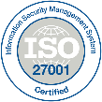
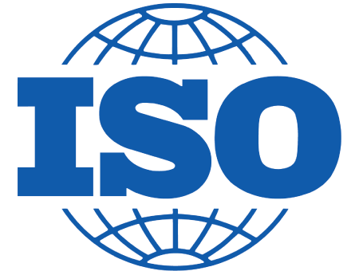




















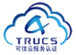













Compliance certifications
GLOBAL
ISO 27001
ISO 27018
ISO 27017
ISO 22301
SOC 1 Type 2
SOC 2 Type 2
SOC 3
CSA STAR
Self-Assessment
CSA STAR
Certification
CSA STAR
Attestation
INDUSTRY
PCI DSS
Level 1
CDSA
MPAA
FACT UK
Shared
Assessments
FISC Japan
HIPAA / HITECH Act
HITRUST
GxP
21 CFR Part 11
MARS-E
IG Toolkit UK
FERPA
GLBA
FFIEC
REGIONAL
Argentina PDPA
EU
Model Clauses
UK
G-Cloud
China
DJCP
China
GB 18030
China
TRUCS
Singapore
MTCS
Australia
IRAP/CCSL
New Zealand
GCIO
Japan My
Number Act
ENISA
IAF
Japan CS Mark Gold
Spain
ENS
Spain
DPA
India
MeitY
Canada
Privacy Laws
Privacy
Shield
Germany IT
Grundschutz
workbook
Notes:
Compliance and trust is not an afterthought at Microsoft.
We are leaders in this space, and help set standards for global and federal organizations around the world.
Microsoft has been talking about trust in the cloud for a while and will continue to do so.
This is only a sampling of our compliance certifications, but we run the gamut.
Azure’s strengths are around security, privacy, and transparency around how we run the cloud.

Slide 20
Windows 10 IoT editions
Windows 10 IoT Core
Minimum requirements:
 CPU x86, x64, or ARM
 RAM 512 MB RAM
 Storage 2GB Storage
Small-footprint smart edge devices
Universal Windows Platform (UWP) app experience
Small hardware footprint
Optimized for devices with and without displays
Support for ARM CPUs
No OS-shell UX
Familiar Windows security, tools, apps and manageability
No operating system royalty
Windows 10 IoT Enterprise
Minimum requirements:
 CPU 1GHz or faster x86 or x64
 RAM 1 GB[32-bit] / 2 GB[64-bit]
 Storage 16 GB[32-bit] / 20 GB[64-bit]
Powerful smart devices
A rich user experience with Win32 and UWP apps
Advanced threat protection and device security
Same deployment, manageability and servicing as desktops
Familiar interface with granular user interface (UI) lockdown controls
Identical to Windows 10 Enterprise, but sold through the OEM channel instead of volume licensing
For details see https://docs.microsoft.com/windows-hardware/design/minimum/minimum-hardware-requirements-overview
Notes:
Create and deploy your solutions faster
Secure your solution from the device to the cloud
Put real smarts in your edge devices
Windows IoT & Azure IoT – Better Together
Microsoft IoT combines Windows IoT and Azure IoT for complete edge to cloud solutions
You don’t have to find, integrate and secure components from multiple vendors which increases support complexity.
Microsoft is a single point of support

Slide 21
Windows 10 IoT editions comparison*
 | IoT Core |  | IoT Enterprise**
User experience | Single UWP app running with supporting background apps & services |  | Traditional Windows shell with advanced lockdown features
Headless supported | Yes |  | Yes
App architecture supported | UWP only |  | UWP & Win32
Cortana | Cortana SDK |  | Yes
Domain join | AAD only |  | AAD & traditional domain
Management | MDM |  | MDM
Device security technologies | TPM, Secure Boot, BitLocker¹, Device Guard & Device Health Attestation |  | TPM, Secure Boot, BitLocker¹, Device Guard, Device Health Attestation & Windows Defender ATP
CPU Architecture support | X86, X64 & ARM |  | x86 & x64
Licensing | Online licensing agreement & direct OEM agreements; no royalty with optional subscription service for support, management & security |  | Direct & indirect embedded OEM agreements
Usage scenarios | Digital signage Smart building IoT gateway Kiosk Manufacturing devices | Human machine interface Smart home devices Wearables Medical devices | Digital signage Industry tablets POS Kiosk IoT gateway | ATM Medical devices Manufacturing devices Thin client Human machine interface
*This feature list is not exhaustive but intended to highlight edition differences ● ** Windows 10 IoT Enterprise is Windows 10 Enterprise with different licensing and distribution. ● ¹Requires TPM 1.2 or greater.

Slide 22

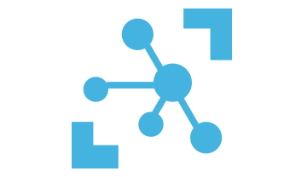

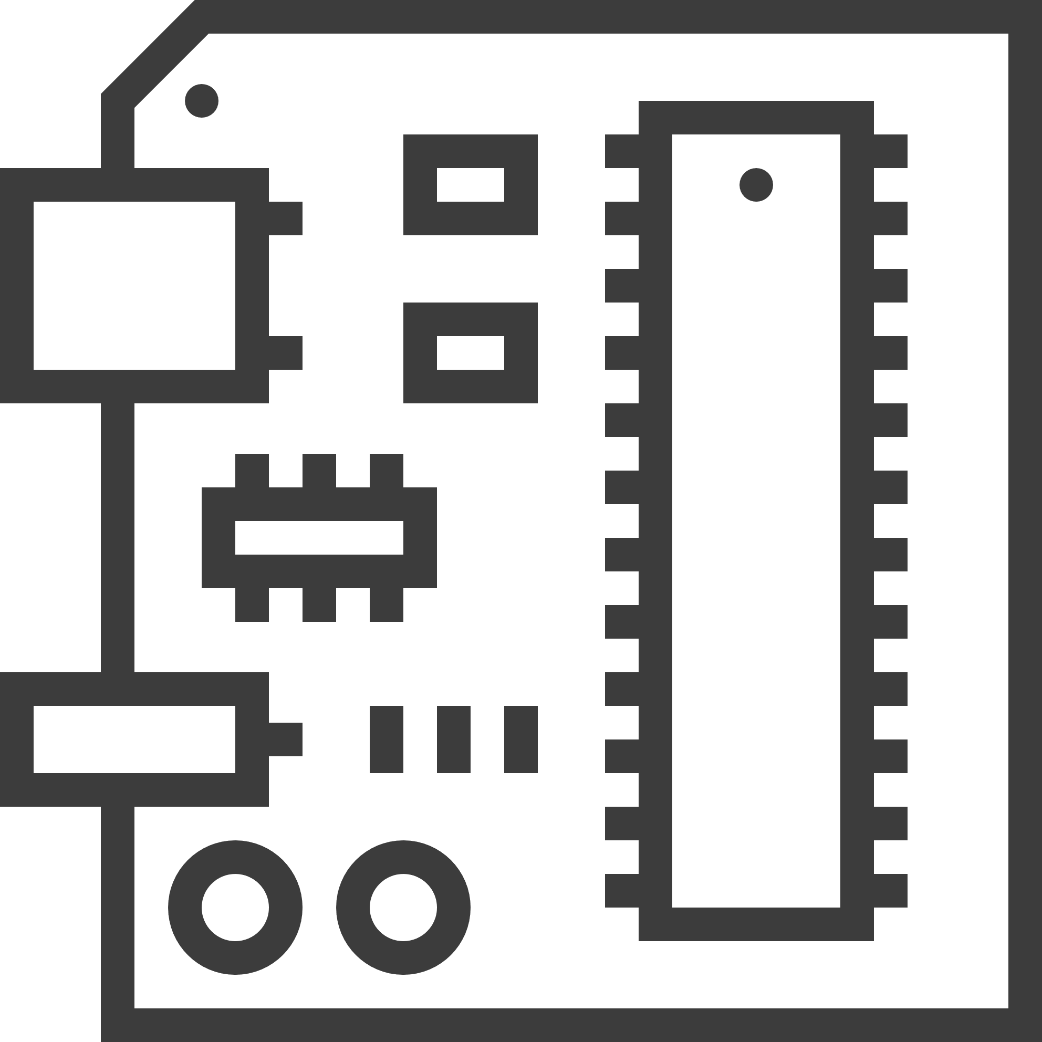

IoT Data Flow
Database
IoT Device
Stream
Analytics
Microsoft Azure IoT Hub
Power BI

Slide 23


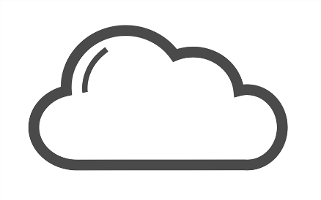




IoT Data Flow
Device SCADA / HMI
Windows IoT Device
Cloud
Data
UEFI
TPM
BitLocker
Secure Boot
Device Guard
Unified Extensible Firmware Interface
Trusted Platform Module

Slide 24
IoT projects are still complex
Security is a challenge
Time-consuming to get started
Incompatible with existing infrastructure
Challenging to scale

Slide 25
Cloud
Notes:
We know that IoT represents a huge opportunity for Microsoft in the Cloud.
Azure + WINDOWS CLOUD

Slide 26
Devices
Cloud
Notes:
But the cloud doesn’t run in a vacuum; it runs connected to devices.
Microsoft is one of the only major players that offers both a cloud platform AND a device platform – customers love this. We provide integration, testing and support

Slide 27
Intelligent Cloud
Intelligent Edge
Intelligent Edge
Notes:
This enables us to unlock this model of an intelligent cloud with an intelligent edge.
The model is motivated by data gravity and putting computing power where it makes the most sense, either locally or in the cloud.
And applies where there may be latency or bandwidth concerns – think of an oil rig where you can’t send all of the data to the cloud, or a robot that needs to navigate a factory floor and can’t wait on cloud latency

Slide 28

Microsoft IoT delivers from the edge to the cloud
Build Things
Control
Anything
Gain
Insights
Take
Action
Windows 10 IoT
Azure IoT Edge
Azure IoT Suite
Microsoft IoT Central
Advanced Analytics
Artificial Intelligence
Dynamics 365
Hololens
Notes:
Mention that security is also integrated across the Microsoft solution

Slide 29
Microsoft IoT provides security from edge to cloud
Device protection
Threat resistance
Data protection in-motion
Cloud security
Response
Trusted Platform Module (TPM)
Windows Device Health Attestation
Secure Boot
BitLocker
Windows as a Service
Device Guard
Windows Firewall
Windows Defender *
X.509/TLS-Based Handshake and Encryption
Encryption at Rest
Azure Active Directory
Key Vault
Policy-Based Access Control
IP- based blocking
Secure Device Registration
Standards-based best practices
Device Management
Device Recovery
Device-specific repudiation
* Only available on Windows IoT Enterprise
Notes:
Slide can be unhidden if desired, integrated Security is a major differentiator for Microsoft IoT

Slide 30
Customer IoT Solution Journey
Operate
Scale
Connect
Build
Windows IoT has hundreds of samples, docs and great tooling to help OEMs scale from a single dev machine to distributed software development projects. Connecting to Azure IoT scales the solution with deployment, provisioning and management. Microsoft provides enterprise grade security and support throughout the process.
Notes:
But enough about us, let’s pivot to your needs on your IoT journey
From our experience, most IoT projects follow these stages
Build
Architect, create & test your solution for efficiency, utility and, of course, security
Connect
The solution needs to be connected on the edge to equipment, sensors, controls, etc.
On the other side, it needs secure robust connectivity to the cloud assets
Scale
After the pilot, the solution often needs to be connected to hundreds or thousands of devices
The devices need to be deployed, connected & provisioned, all in a secure manner
Operate
The devices in the field need to managed & updated, all in a secure manner
Ongoing support costs need to be optimized for predictable issue resolution

Slide 31

Build Building a Windows device is as easy as building an app
Windows ‘just works’, built-in security, connectivity and NUI options
Hundreds of samples, docs, and great tooling to guide you
Familiar development environment with best in class dev tools
Shell lockdown/OEM customization and a robust set of language-locales
Notes:
Building a device is as easy as building an app:
Visual Studio can scale its world class development environment to enterprise level distributed teams
Use the app languages (C#, .Net, Python, Node.js) you love
Easily access hardware directly from app code (Windows.Devices.GPIO)
Sandbox protection of UWP stabilizes your system and gives you piece of mind
Windows ‘just works’ – no messing with distro mixing, OSS code for basic functionality etc.
Security
Hardware
Connectivity
NUI (Touch, Ink, Cortana, Speech, Vision)
Windows has hundreds of samples, docs, and great tooling to guide you.
Windows provides OEMs with build, test, gates, and flighting tools that scale from single dev machines to distributed software development projects
Windows supports shell lockdown/OEM customization and a robust set of language-locales which enables our partners to create specialized solutions that can be deployed and managed globally

Slide 32
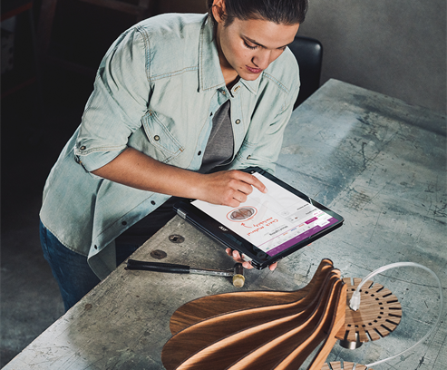
Connect Bringing the Intelligent Edge to the Intelligent Cloud for a complete solution
Azure IoT shines brightest on Windows
Built-in connectivity with Azure IoT provides advanced capabilities including Machine Learning and Artificial Intelligence
Key technologies like OPC-UA, and OCF work great with Windows
Able to connect to a wide variety of disparate existing devices
Notes:
Azure IoT’s features shine brightest on Windows (DM, DP, Edge, Hub, Central, etc) – like Surface Studio makes Office shine.
No need to install anything extra on your device, with Windows 10 IoT, it can connect to Azure IoT right out of the box to access things like
* Azure IoT Hub – Connect, Monitor and control billions of IoT assets
* Azure IoT Suite – Capture and analyze untapped data to improve business results
* Event Hubs – Receive telemetry from millions of devices
* Stream Analytics – Real-Time data stream processing from millions of IoT devices
* Machine Learning – Powerful cloud based predictive analytics tool to enable predictive maintenance
* Time Series Insights – Instantly explore and analyze time-series data
* Notification Hubs – A scalable, push notification engine for quickly sending millions of messages
Windows 10 IoT can connect to industrial systems such as PLCs, industry PCs and sensors via OPC-UA. (Open Platform Communications-Unified Architecture)
Windows 10 IoT can also connect to the Robot Operating System to send and receive data from the host robots
Microsoft has joined with other industry leaders to create the Open Connectivity Foundation to create specs & protocols to enable devices from a variety of manufactures to securely and seamlessly interact with one another. Regardless of the manufacturer, operating system, chipset or transport – devices that adhere to the OCF specifications will simply work together.

Slide 33

Scale Enabling OEMs to quickly scale while keeping devices updated and secure
Kickstart manufacturing with tooling and relationships to get your product built-right and on-time
Utilize Microsoft’s update infrastructure to keep devices secure and up-to-date
Advanced system security protects data in-motion and at-rest
Application servicing and telemetry done via Microsoft Store
Notes:
Microsoft provides manufacturing guidance to help our customers create images that can quickly be flashed to new devices.
Customers can leverage Microsoft's global update system for OS & app updates.
Windows 10 IoT systems have an array of device, network & cloud security features. On the device, security technologies include Secure Boot, Device Encryption with BitLocker, Device Guard, Device Health Attestation and Defender Advanced Threat Protection. The last one uses AI & ML to monitor, respond & remediate threat vectors.
Microsoft's business-class application store can be used to service apps and provide ISVs with advanced telemetry.

Slide 34
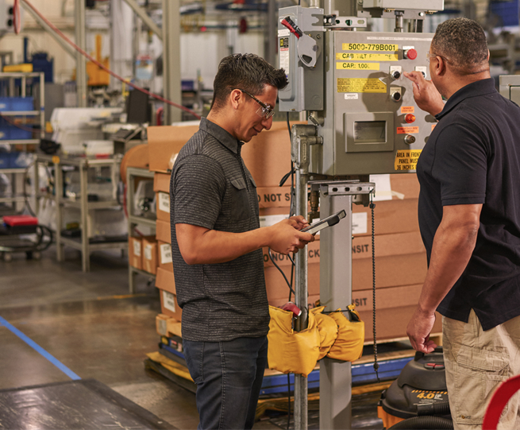
Operate Doing the hard work so our customers can focus on value generation
Lower sustained engineering resulting in lower Total Cost of Ownership
Direct Microsoft Support for the OS and an ecosystem of support options for your solution
Windows works in Enterprise IT environments with the built-in management and update requirements they expect
Notes:
Windows supports silicon with long-life and IoT hardware specifications
Microsoft provides enterprise level support with defined policies and lifecycles
Windows provides technologies to ensure durability and long life of your products (ex: UWF, PowerMgmt)
GPDR is the EU's upcoming privacy regulation and Microsoft has whitepapers to help customers comply
Blog here https://blogs.windows.com/windowsexperience/2017/09/25/windows-resources-to-help-support-your-gdpr-compliance
Microsoft Windows 10 IoT can be managed by the same systems used to manage general purpose Windows PCs and Laptops. This includes policies and updates to keep them secure and up-to-date

Slide 35
Prototype to production.
With you all the way.
Notes:
Now we’re going to learn how Windows 10 IoT provides value at every step along the journey of creating and running an IoT solution

Slide 36

© 2016 Microsoft Corporation. All rights reserved.
Notes:
Thanks for your time.

